Slide 1
Human Resource Management

Slide 2
Areas covered include.....
Understanding the importance of the human resource management process and the external influences that might affect that process.
Discussing the tasks associated with identifying and selecting competent employees.
Explaining the different types of orientation and training.
Describing strategies for retaining competent, high-performing employees.
Discussing contemporary issues in managing human resources.

Slide 3
Introduction
Once an organisation’s structure is in place, it’s time to find the people to fill the jobs that have been created. That’s where human resource management comes in.
It is an important task that involves getting the right number of the right people in the right place at the right time.
The quality of an organisation is, to a large degree, dependent upon the quality of the people it hires and retains.
This topic examines the concepts of human resource management.

Slide 4
The HRM Process
Various studies have concluded that an organisation’s human resources can be an important strategic tool and can help establish a firm’s sustainable competitive advantage.
It is important to understand the following;
1. Why Is Human Resource Management Important?
2. External Factors that affect the HRM Process, such as;
Recent economic changes,
Unionisation,
Laws & Regulations,
Demographic trends.

Slide 5
Why Is HRM Important?
Whether or not an organisation has a human resource department, every manager is involved with human resource management activities.
3 Reasons
1st - Studies have concluded, it can be a significant source of competitive.
2nd - As an important strategic tool, to be used as part of organisational strategies.
3rd - The way organisations treat their people, has been found to significantly impact organisational performance.

Slide 6
Why Is HRM Important? ….3 Reasons
1st - Studies have concluded, it can be a significant source of competitive advantage.
People-oriented HR creates superior shareholder value
Achieve competitive success through people by treating employees as partners
2nd - As an important strategic tool, to be used as part of organisational strategies.
Achieving competitive success through people means managers must change how they think about their employees and how they view the work relationship.
3rd - The way organisations treat their people has been found to significantly impact organisational performance.
High performance work practices lead to both high individual and high organisational performance
For instance, one study reported that improving work practices could increase market value by as much as 30 percent (anon, 1995)

Slide 7
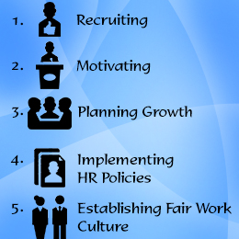
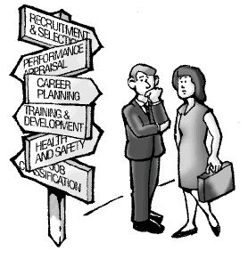
Responsibilities of HR Managers …

Slide 8
Why Is HRM Important?
Studies that have explored the link between HRM policies and practices and organisational performance have found that certain HRM policies and practices have a significant impact on performance.
These high-performance work practices are human resource policies and practices that lead to both high individual and high organizational performance.
E.g. use of self managed teams, or performance based compensation
(More examples next slide)

Slide 9
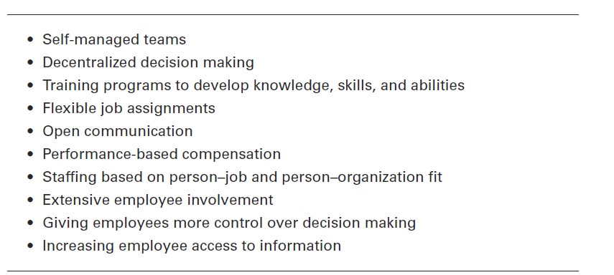
Examples of High-Performance Work Practices

Slide 10
The HRM Process
Even if an organisation does not use high-performance work practices, other specific HRM activities must be completed in order to ensure that the organisation has qualified people to perform the work that needs to be done - activities that comprise the HRM process.
Human resource management process consists of eight activities necessary for staffing the organisation and sustaining high employee performance.
(see next slide)

Slide 11
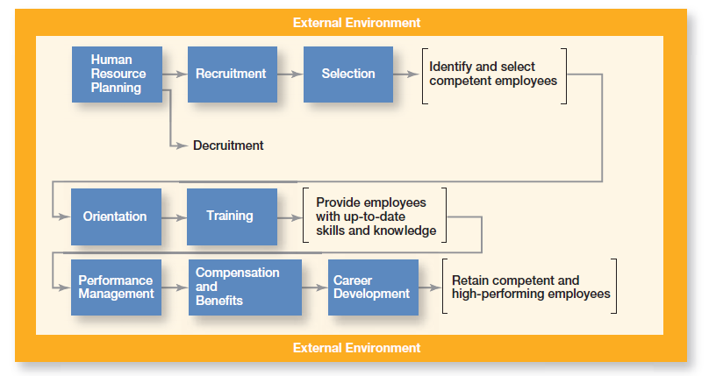
8 Activities in the HRM Process

Slide 12
External Factors That Affect the HRM Process
The entire HRM process is influenced by the external environment.
Those factors most directly influencing it include ;
the economy,
employee labour unions,
governmental laws and regulations,
demographic trends.

Slide 13
External Factors - The Economy
Recent economic changes have had a profound impact on the nature of work.
Unemployment is high in most developed countries due to the latest recession felt world-wide.
Economic news, whether good or bad, has an effect on employment, attitudes toward work, careers, and retirement.
The global economic downturn has left what many experts believe to be an enduring mark on HRM practices worldwide.
Lifetime employment is long gone and corporate pensions are collapsing.

Slide 14
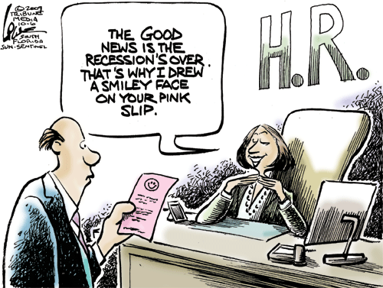

Slide 15
External Factors - The Economy
In the Europe (2022) average unemployment rate of 6.6%,
Kosovo having the highest rate, 20.5%
The Czech Republic has lowest rate 2.3%
Ireland having unemployment rate of 4.2% (europa.eu, July 2022)
In the United States, labour economists say that as jobs come back from periods of recession or low employment, they are not the same ones that employees were used to.
Many of these jobs are temporary or contract positions, rather than full-time jobs with benefits.
U.S. workers have dramatically lowered their career and retirement expectations for the foreseeable future.

Slide 16
External Factors: Employee Labour Union
Unionisation can affect a company’s human resource management activities.
A labour union is an organisation that represents workers and seeks to protect their interests through collective bargaining.
In unionised organisations, many HRM decisions are dictated by collective bargaining agreements, which usually define things such as;
recruitment sources,
criteria for hiring,
promotions and layoffs,
training eligibility
and disciplinary practices.

Slide 17
External Factors: Employee Labour Union
Work stops, labour disputes, and negotiations between management and labour are just a few of the challenges organisations and managers face when their workforce is unionised.
Good labor-management relations, the formal interactions between unions and an organisation’s management, are important.
Although only about 13% (2022) percent of the workforce in the United States is unionised, that percentage is higher in other countries.
Current estimates, % of employees in a union varies globally …..
France 9%, Sweden 82% (highest), Finland 76%, Ireland 45%,
Germany 27%, Japan 22%, New Zealand 22%, Canada 30%, Mexico 19%
Indications that unionisation in private sector is dropping, and union membership in public sector is increasing.
(‘Union membership as a % of employees’, Nationmaster.com, Nov 2022)

Slide 18
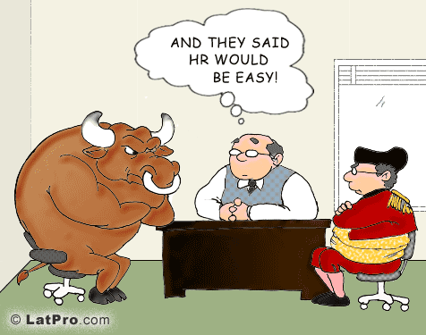
HR & Union Negotiations!

Slide 19
External Factors: Legal Environment
An organisation's HRM practices are governed by a country’s laws.
A number of important laws and regulations affect what you can and cannot do legally as a manager.
Because workplace lawsuits are increasingly targeting supervisors, as well as their organisations, managers must know what they can and cannot do by law.
Decisions regarding who will be hired, which employees will participate in a training programme, or what pay or benefits an employee will receive, must be made without regard to race, religion, sex , age colour, nationality, or disability.
Balance of the “should and should-not’s” of many of these laws often fall within the realm of affirmative action (‘positive action’)- programs that enhance the organisational status of members of protected groups.

Slide 20
External Factors: Legal Environment
Affirmative action/ Positive Action - organisational programs that enhance the status of members of protected groups
Many U.S. organisations have affirmative action programs to ensure that decisions and practices enhance the employment, upgrading, and retention of members from protected groups such as minorities and females.
….. That is, an organisation refrains from discrimination and actively seeks to enhance the status of members from protected groups.
Exceptions can occur in particular circumstances – it is possible to refuse an application for a fireman position from someone in a wheel chair, but they may apply for a desk job, such as a dispatcher,
The disability can not be used as a reason to deny employment.
Although laws have helped reduce employment discrimination and unfair work practices, they have also reduced management discretion over HRM decisions.

Slide 21


Slide 22
External Factors: Legal Environment
Two current U.S. laws that each have the potential to affect future HRM practices;
Protection and Affordable Care Act (PPACA and commonly called the Health Care Reform Act)
The first of these, the Patient Protection and Affordable Care Act (PPACA and commonly called the Health Care Reform Act), was signed into law in March 2010 and upheld by the Supreme Court of the United States in 2012. (Kushner, 2012)
Social Networking Online Protection Act (SNOPA)
Currently a proposed law - SNOPA has been introduced and would prohibit employers from requiring a username, password, or other access to online content. (Smith, 2012)

Slide 23
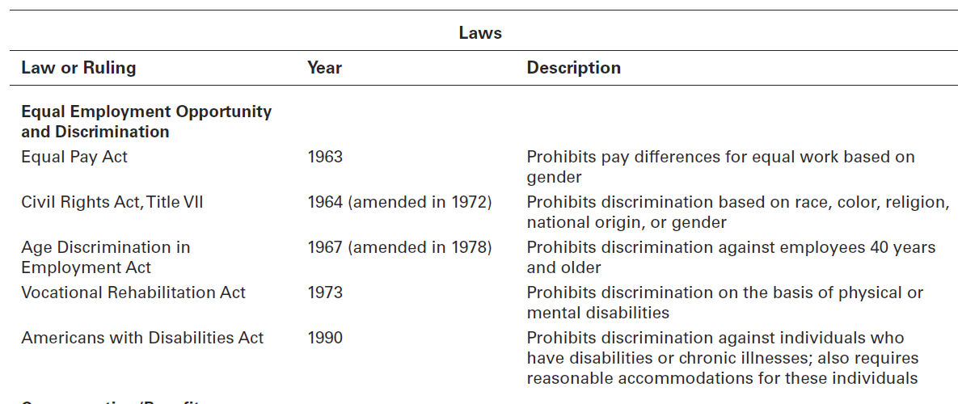
Important U.S. Laws that Affect the HRM Process

Slide 24
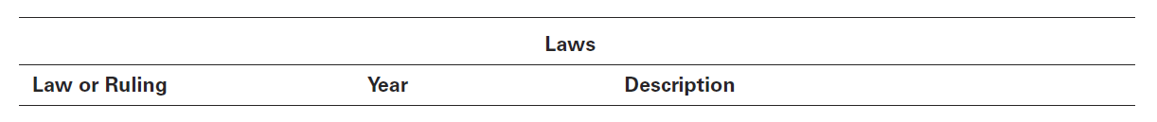
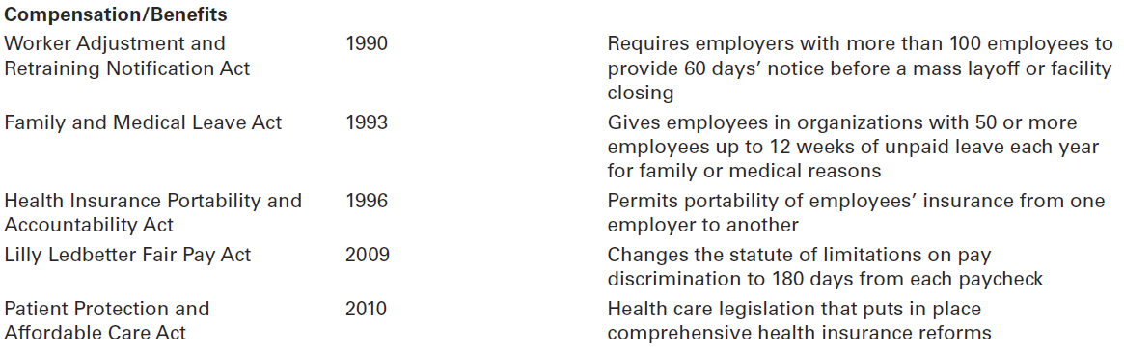
Important U.S. Laws that Affect the HRM Process (Cont.)

Slide 25
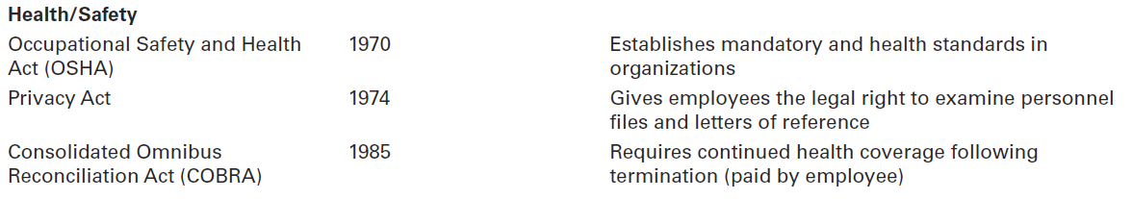
Important U.S. Laws that Affect the HRM Process (Cont.)

Slide 26
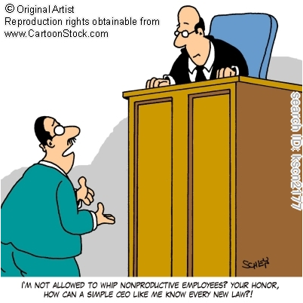
“I’m not allowed to whip non productive employees? Your Honour, how can a simple CEO like me know every law?

Slide 27
Legal Environment: Global HRM Laws
Managers that operate in an international context must also be aware of specific laws that apply to the countries in which they do business.
Canadian laws most closely mirror those in the U.S.
In Mexico, employees are more likely to be unionised.
In Australia, discrimination laws are fairly new and generally apply to affirmative action for women.
In Germany, companies are required to have a high degree of worker participation in management through the use of work councils and board representatives.

Slide 28
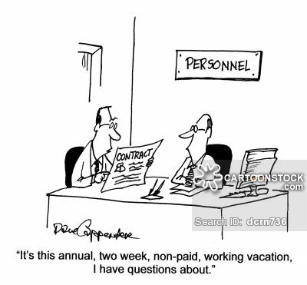

Slide 29
Legal Environment: Global HRM Laws
German HR practices similar to most Western European countries.
Legislation requires companies to practice representative participation, in which the goal is to redistribute power within the organisation, putting labour on a more equal footing with the interests of management and shareholders.
Two common forms of representative participation are Work Councils and Board Representatives.
Work Councils - Link employees with management .
They are groups nominated or elected employees who must be consulted when management makes decisions involving personnel
Board representatives are employees who sit on a boards company of directors and represent the interests of the firms employees.

Slide 30
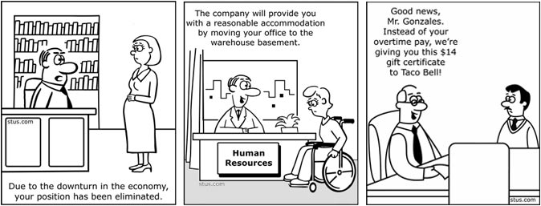

Slide 31
External Factors: Demographic Trends
Demographic trends will continue to play an important role in the Human Resource function as the pool of workers change, i.e.
increase in older workers ready for retirement and greater ethnic diversity due to an increasing number of Hispanics residing in the US.
Mobility of labour between EU member states
Workforce trends in the first half of the twenty-first century will be notable for three reasons:
(1) changes in racial and ethnic composition,
(2) an aging baby boom generation, and
(3) an expanding cohort of Gen Y workers (born between 1981 – 1996)

Slide 32
External Factors: Demographic Trends
(1) changes in racial and ethnic composition,
In the USA - by 2050,
Hispanics will grow from today’s 13 percent of the workforce to 24 percent,
African Americans, will increase from 12 percent to 14 percent,
and Asians will increase from 5 percent to 11 percent.
(2) an aging baby boom generation,
Meanwhile, the labour force is aging.
Over 37% of total US workforce are 50 years or older,
Over 16% of total US workforce are 60 years or older
(US Bureau of Labor Statistics, Nov 2022)

Slide 33
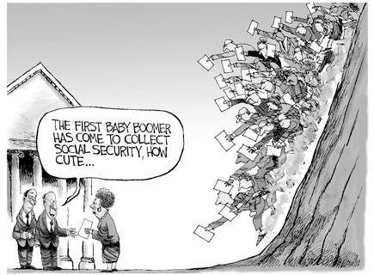

Slide 34
External Factors: Demographic Trends
(3) an expanding cohort of Gen Y workers.
Another group that is having a significant impact on today’s workforce is Gen Y, a population group that includes individuals born from about 1978/1981 to 1996.
Gen Y has been the fastest-growing segment of the workforce; increasing from 14 percent to more than 24 percent.
With Gen Y now in the workforce, analysts point to the four generations that are working side-by-side in the workplace.
The oldest, most experienced workers (those born before 1946) make up 6 percent of the workforce.
The baby boomers (those born between 1946 and 1964) make up 41.5 percent of the workforce.
Gen Xers (those born 1965 to 1977) make up almost 29 percent of the workforce.
Gen Yers (those born 1978 to 1994) make up almost 24 percent of the workforce

Slide 35
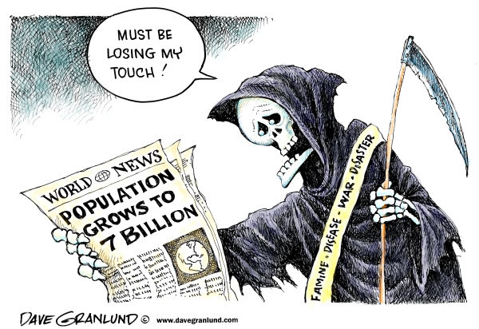

Slide 36
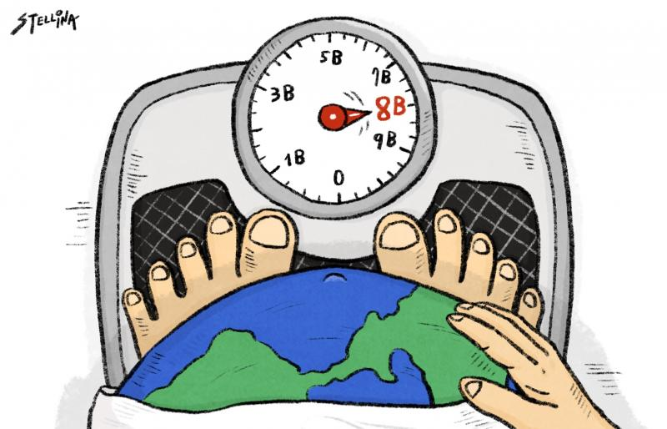
World Population reaches 8 Billion- November 2022

Slide 37
External Factors: Demographic Trends A Response from BMW
In 2007, the head of BMW's 2,500 employee power plant in Dingolfing, Lower Bavaria, was worried about the potential inevitable future decline in productivity due to an aging workforce.
Company executives decided to redesign its factory for older workers.
With input from employees, they implemented physical changes to the workplace, e.g.:
new wooden floors to reduce joint strain,
and special chairs for sitting down or relaxing for short periods, that would reduce wear and tear on workers' bodies.

Slide 38
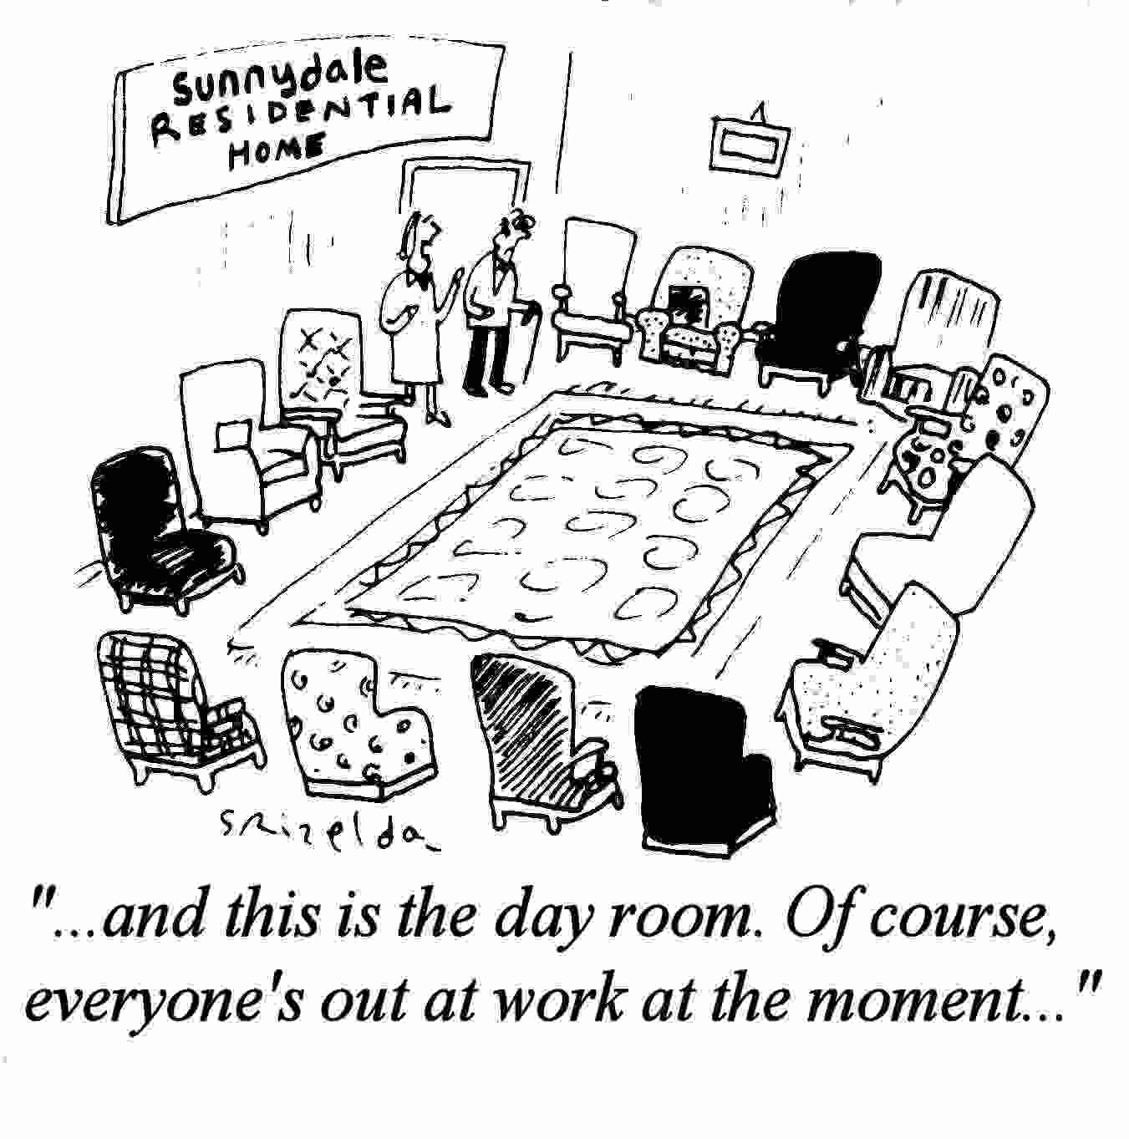

Slide 39
Miscellaneous data re HRM
83% of companies cite a shortage of talent as their number one hiring challenge.
91% of recent college graduates say that if they started a job and did not like it, they would stay in that job for up to a year.
52% of HR professionals say they do not use social networking sites to research job candidates.
85% of survey respondents said the top reason for why an employee should be terminated is sexually harassing a co-worker.
6.25 seconds is the time recruiters spend looking at a resume before deciding whether the candidate is a good fit for a job.
61% of workers surveyed say they are never late for work.
15% of employers say they have fired a worker for calling in sick without a legitimate excuse.
36% of respondents say the top reason why someone hired would not work out in a position (other than poor performance) is a mismatched skill set.
39% of HR managers say that annual performance reviews are not an accurate appraisal of employees' work.
38% of senior managers say the most common mistake candidates make during job interviews is having little or no knowledge of the company.
82 % of employees say they would give up more than 5 percent of their salary to get a guaranteed retirement income.

Slide 40
Identifying & Selection Competent Employees
This process involves;
Human Resource Planning,
Recruitment and de-recruitment
Selection

Slide 41
Human Resource Planning
Human resource planning is ensuring that the organisation has the right number, and kinds of capable people in the right places and at the right times.
With methodical planning, organisations avoid sudden people shortages and surpluses.
HR Planning entails two steps:
(1) assessing current human resources and
(2) meeting future HR needs.

Slide 42
HR Planning: Current Needs
Managers begin HR planning by conducting a current assessment of the organisation’s human resource status.
This assessment is typically accomplished through a human resource inventory.
An important part of this current assessment is job analysis.

Slide 43
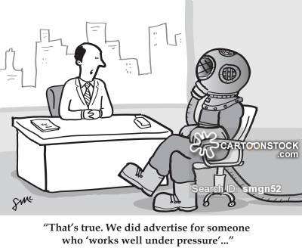
“That’s true. We did advertise for someone who ‘works well under pressure”

Slide 44
HR Planning: Current Needs
Job analysis is an assessment that defines jobs and the behaviors necessary to perform them.
Information for a job analysis is gathered by;
directly observing individuals on the job,
interviewing employees individually or in a group,
having employees complete a questionnaire or record daily activities in a diary,
or having job “experts” (usually managers) identify a job’s specific characteristics.
Databases are used to help this assessment; e.g.…..
Director of Personnel for North & South America, (Schlumberger’s, Ms. Stephanie Cox), uses a company HR Planning programme, called ‘PeopleMatch’, to help identify managerial talent, , if she needs a manager for Brazil, she types in qualifications & someone who can speak Portuguese , is willing to relocate, and is a “high potential employee”, the programme generates a list of possible suitable employees .

Slide 45
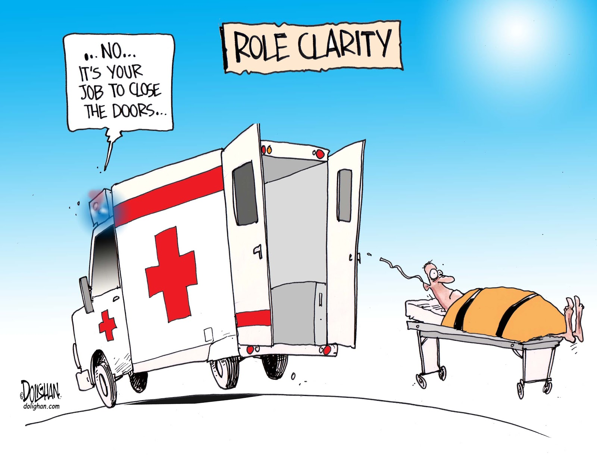

Slide 46
HR Planning: Current Needs
From the information in a job analysis, management can draw up a job description.
A job description (sometimes called a position description) is a written statement describing a job;
typically job content,
environment,
and conditions of employment.

Slide 47
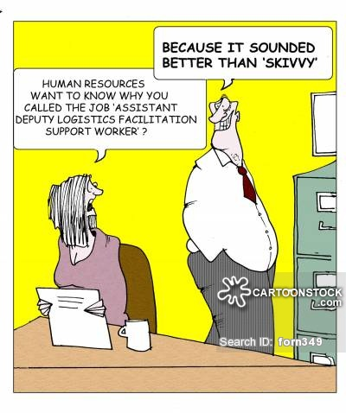

Slide 48
HR Planning: Current Needs
In addition, management must develop a job specification.
A job specification states the minimum qualifications that a person must possess to successfully perform a given job.
It identifies the knowledge, skills, and attitudes needed to do the job effectively.
Both the job description and job specification are important documents when managers begin recruiting and selecting.

Slide 49
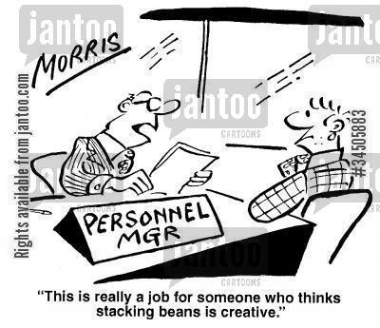
Example of Job Specification

Slide 50
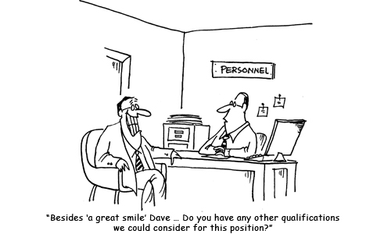
Job Specification

Slide 51
HR Planning: Future Needs
HR future needs are determined by the organisations mission, goals ands strategies.
Demand for employees results from demand for the organisations products or services.
E.g. – if a company, is planning on expanding into new global territories, suitable employees need to be selected from existing staff or recruited
If product development and product range expansion is a strategy ..… appropriate staff are required to make this a reality.
Developing a future program requires estimates in which the organisation will be understaffed or overstaffed.
After assessing current capabilities and future needs …. then managers can estimate areas in which the organisation may be under staffed ,… or over staffed.
They are ready for the next step in the HRM process.

Slide 52
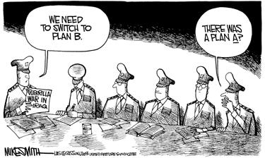
Planning for Future Needs

Slide 53
Recruitment
If employee vacancies exist, managers should use the information gathered through job analysis to guide them in recruitment.
Recruitment is the process of locating, identifying, and attracting capable applicants.
Job candidates can be found using a number of different sources
Many approaches taken by organisations, ..…
McDonalds held a ‘World Hiring Day’ hoping to hire 50,000 employees, they hired 62,000 staff.
Microsoft – website which integrated 103 countries into one web site career website, potential employees find blogs on interview and CV tips when applying to the firm.
Google – receives 3,000 applicants every day, can be choosy, but they still have specific needs for Computer Science and engineering candidates.

Slide 54
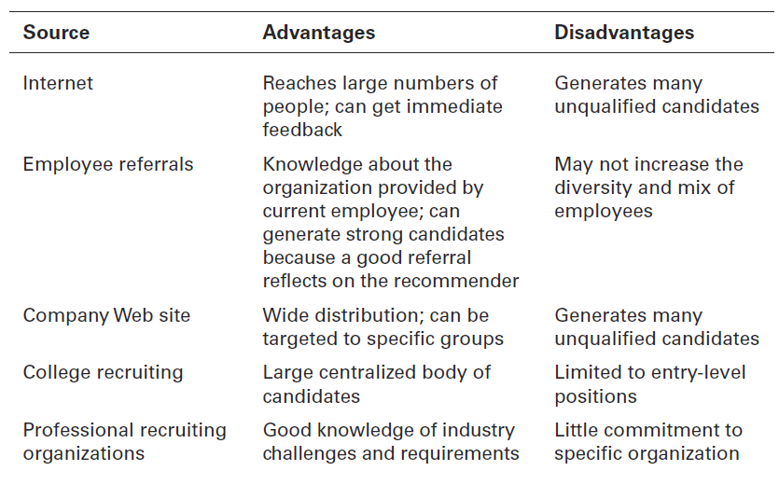
Recruitment Sources Managers Can use to Find Potential Candidates

Slide 55
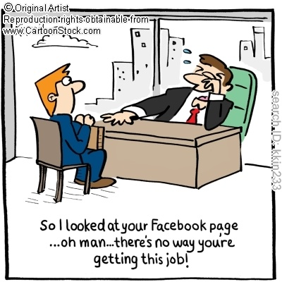
Recruitment

Slide 56
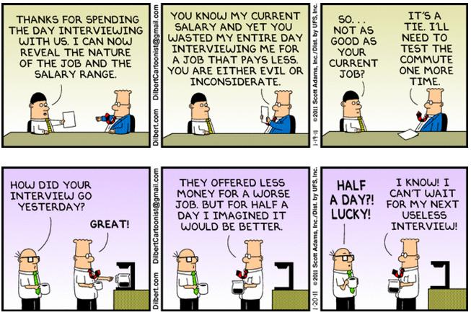
Recruitment

Slide 57
De-Recruitment
If HR Planning shows a surplus of employees, managers may want to reduce the organisation’s workforce through de-recruitment.
De-recruitment is reducing an organisation’s workforce.
Although employees maybe fired, other choices may be better.
De-recruitment options include;
firing,
layoffs,
attrition,
transfers,
reduced workweeks,
early retirements,
and job sharing.
The tasks of de-recruitment is considered to be an extremely unpleasant management task.

Slide 58
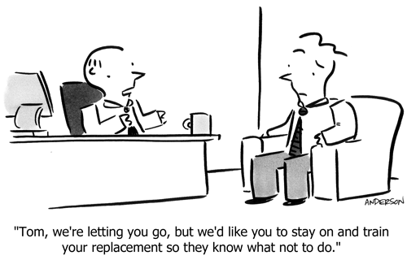

Slide 59
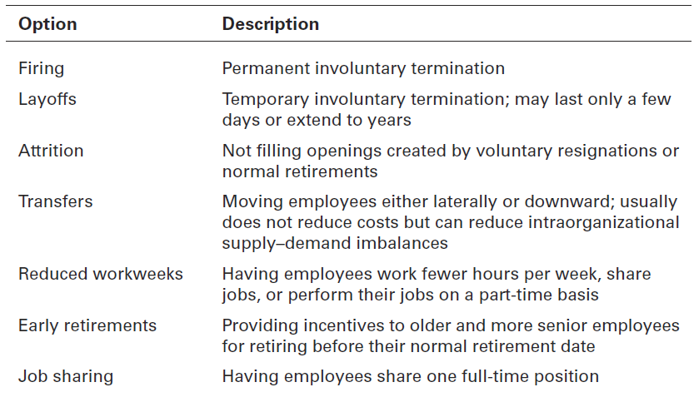
De-recruitment Options

Slide 60
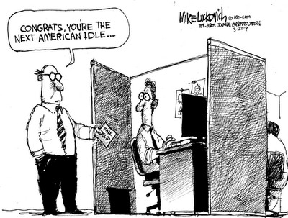
De-Recruitment

Slide 61
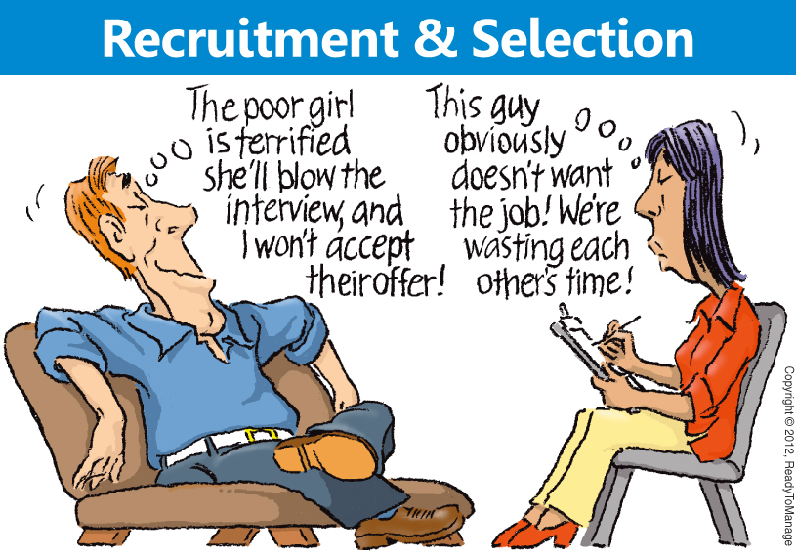

Slide 62
Selection
Once an organisation has a pool of candidates, the next step in the HRM process is selection.
Selection – is screening job applicants to ensure that the most appropriate candidates are hired;
Managers need to “select” carefully since hiring errors can have significant implications.
Selection is an exercise in prediction …..
…. predicting which candidates will be successful if hired.
E.g.: if hiring for a sales position, the selection process should predict which candidate will generate a high volume of sales.

Slide 63


Selection: The Decision
Prediction is important because any selection decision can result in four possible outcomes (see next slide)
The major aim of any selection activity should be to reduce the probability of making reject errors or accept errors, while increasing the probability of making correct decisions.

Slide 64
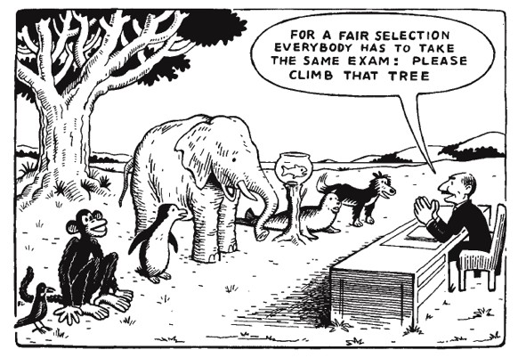

Slide 65
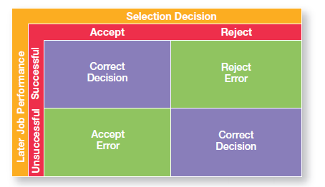
Selection Decision Outcomes
Any selection decision can result in four possible outcomes - two correct and two errors.

Slide 66
Selection Decision Outcomes
Problems arise when errors are made;
in rejecting candidates who would have performed successfully on the job (reject error),
or accepting those who later perform poorly on the job (accept errors).
These mistakes can be costly….
Reject errors – can expose the firm to discrimination charges,
especially if applicants from protected groups are disproportionately rejected.
Accept errors – can cost additional training, loss of profits as a result of employee incompetence, cost of severance pay, additional recruiting costs.
Managers try to reduce the possibility of Accept & Reject Errors while increase the probability of making correct decisions,
They do this by using selection procedures that are both valid & reliable.

Slide 67
Selection: Validity
A valid selection device is the proven relationship between the selection device and some relevant criterion.
In the USA employment laws prohibit managers from using test scores to select employees, unless there is clear evidence that once on the job, individuals with high test scores, outperform individuals with low test scores.
The burden is on managers to support any selection device they use, to differentiate applicants, is validly related to job performance.

Slide 68
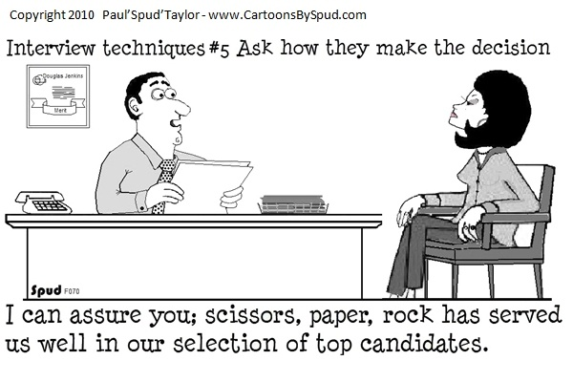
Selection Validity!

Slide 69
Selection: Reliability
A reliable selection device is the ability of the selection device to measure the same thing consistently.
On a test that is reliable, any single individual’s score should remain fairly consistent over time.
No selection device can be effective if is not reliable.
If a baker is using a measuring scale to weigh out ingredients – if it randomly fluctuates 5 to 10 lbs every time it is used – the results are useless.

Slide 70
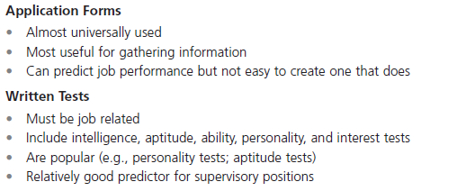
Selection: Tools
The best-known selection tools include application forms, written and performance-simulation tests, interviews, background investigations, and in some cases, physical exams.
The strengths and weaknesses of each – detailed below, and on next slides

Slide 71
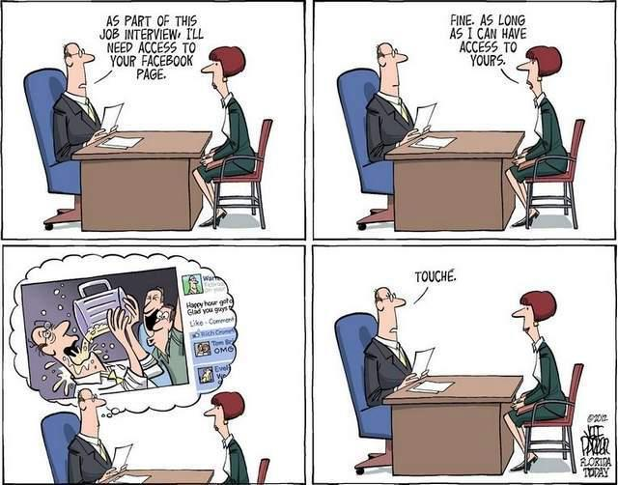

Slide 72
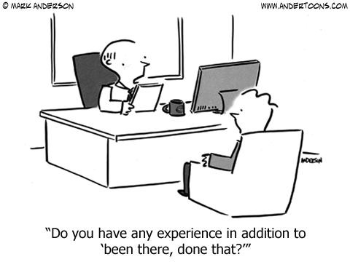

Slide 73
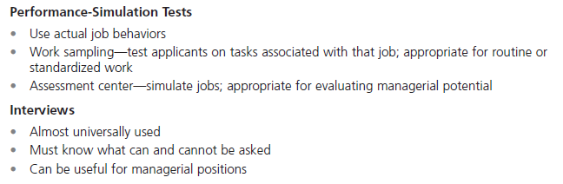
Selection: Tools

Slide 74
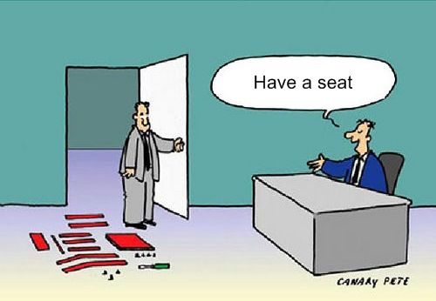

Slide 75
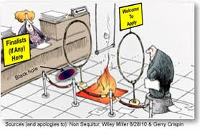
Selection

Slide 76
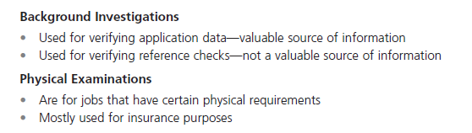
Selection: Tools

Slide 77
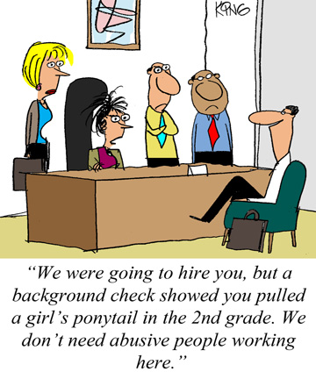

Slide 78
Selection: Realistic Job Preview
One thing managers need to carefully watch is how they portray the organisation and the work an applicant will be doing.
If they tell applicants only the good aspects, they are likely to have a workforce that is dissatisfied and prone to high turnover.
To increase employee job satisfaction and reduce turnover, managers should consider a realistic job preview (RJP),
one that includes both positive and negative information about the job and the company.

Slide 79


Slide 80
Providing Skills & Knowledge
Methods to provide employees with skills and knowledge of the job and the organisation include;
1. Orientation
Work unit orientation
Organisation orientation
2. Employee training
Traditional training methods
Technology driven methods

Slide 81
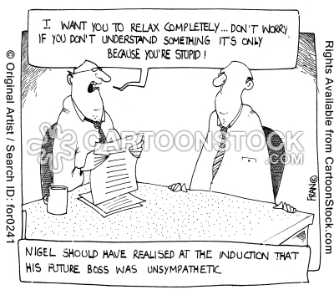
Orientation

Slide 82
Skills and Knowledge: Orientation
A person starting a new job needs the same type of introduction to his or her job and the organisation.
This introduction is called orientation.
Successful orientation results in an ‘outsider’ feeling like an ‘insider’,
it makes a new employee feel comfortable and well adjusted,
it lowers the likelihood of poor work performance
and reduces the likelihood of very quick resignations one or two weeks into the job.

Slide 83
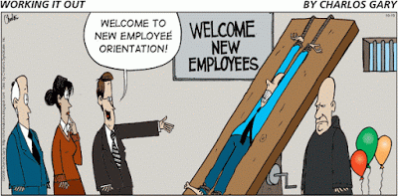

Slide 84
Skills and Knowledge: Orientation
There are two types of orientation;
Work unit orientation;
familiarises the employee with the goals of the work unit,
clarifies how his or her job contributes to the unit’s goals,
and includes an introduction to his or her new coworkers.
Organisation orientation;
informs the new employee about the company’s goals,
History & philosophy,
procedures and rules.
It should also include relevant HR policies and maybe even a tour of the facilities.

Slide 85
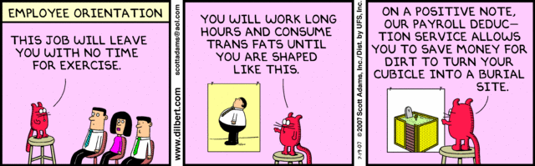
Orientation

Slide 86
Skills and Knowledge: Orientation
Major objectives of orientation include the following:
To reduce initial anxiety,
To familiarise new employees with the job, the work unit, and the organization,
To facilitate the outsider-insider transition.
Formal orientation programs are prevalent in many organisations, particularly in large ones.
Managers have an obligation to new employees to ensure that their integration into the organisation is as smooth and as comfortable as possible.

Slide 87
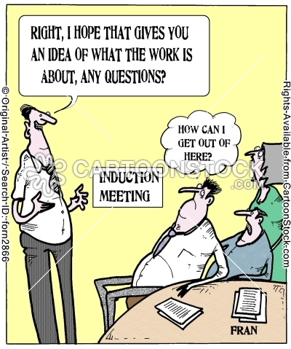
Orientation

Slide 88
Skills and Knowledge: Training
Employee Training is a critical element of the HRM activity.
Approximately ¾ of airline crashes are a result of human error (pilot error, air traffic controller error or inadequate maintenance),
Most of this could have been avoided with adequate training.
The remarkable 2009 landing on the Hudson river in New York, of the aircraft by Pilot Sullenberger, he attributes to intensive and extensive training.
As job demands change, employee skills have to change.
In 2021, U.S. business firms spent more than $92 billion on formal employee training.
Managers, are responsible for deciding what type of training employees need, when they need it, and what form that training should take.

Slide 89
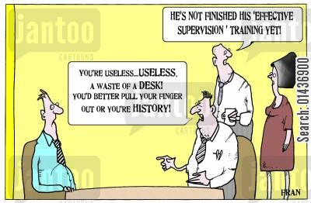

Slide 90
Skills and Knowledge: Training
Types of training include general and specific.
Some of the most popular types include;
profession/industry- specific training,
management/supervisory skills,
mandatory/compliance information (such as sexual harassment, safety, etc.),
and customer service training.
Next slide describes the general & specific types of training that organisations provide.

Slide 91
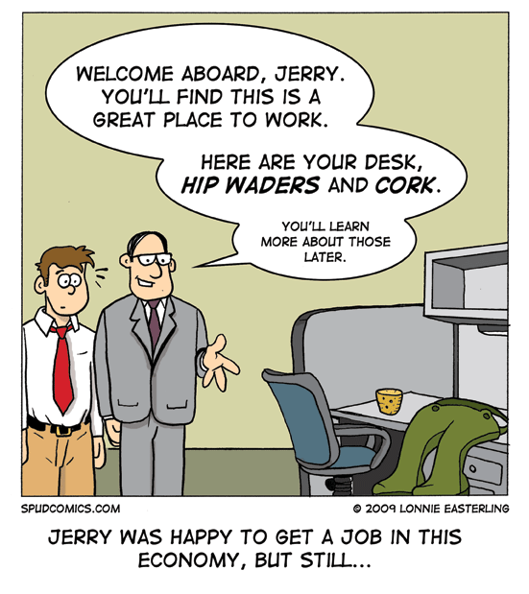

Slide 92
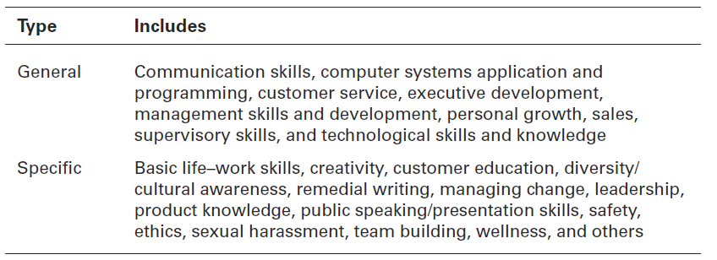
General & Specific Training

Slide 93
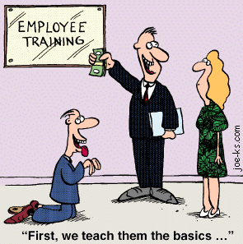

Slide 94
Skills and Knowledge: Training
Traditional Training methods
On-the-job training;
is very common, and it may involve job rotation.
Job rotation;
is on-the-job training that involves lateral transfers to enable employees who work on the same level of the organisation to work in different jobs.
On-the-job training can also involve mentoring, coaching, experiential exercises, and classroom training.

Slide 95
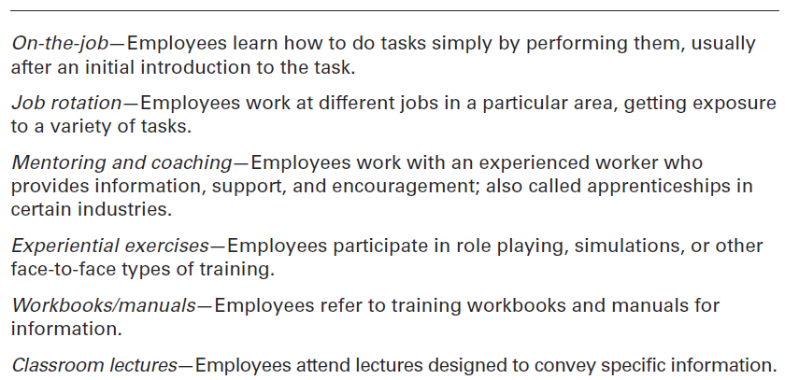
Traditional Training Methods

Slide 96

Training Methods

Slide 97
Skills and Knowledge: Training
Technology-driven training methods
Today’s organisations are increasingly relying on technology-based training,
including e-learning applications to communicate important information and to train employees.
Of all these training methods, experts believe that organisations will increasingly use e-learning and mobile applications to develop employees’ skills.

Slide 98


Slide 99

Technology Driven Training Methods

Slide 100

Training Methods

Slide 101


Slide 102
Retaining Competent, High Performing Employees
Managers need to know whether their employees are performing their jobs efficiently and effectively and when improvement is needed.
Additionally, organisations must retain their best staff, they have various methods to attempt to achieve this with by use of;
1. ‘Employee Performance Management methods,
2. Compensation and benefits

Slide 103


Slide 104
Retaining Employees: Performance Management System
A performance management system establishes performance standards that are used to evaluate employee performance.
Performance appraisal method;
70% of managers admit they have trouble giving critical performance reviews to an underachieving employee.
It is particularly difficult when managers & employee both feel they are not beneficial.
It can be made a little easier if managers use any of the Seven different performance appraisal methods, detailed on next slides.

Slide 105

Performance Appraisal

Slide 106
Retaining Employees: Performance Appraisal Methods
1. A written essay appraises performance through a written description of an employee’s strengths and weaknesses, past performance, and potential.
2. Critical incidents are used to appraise performance by focusing on the critical job behaviors.
In this technique the appraiser writes anecdotes to describe what the employee did that was especially effective or ineffective.
Only specific behaviors, rather than vaguely defined personality traits, are cited.

Slide 107

Performance Appraisal

Slide 108
Retaining Employees: Performance Appraisal Methods
3. The use of graphic rating scales is one of the oldest and most popular performance appraisal methods.
This method appraises performance using a rating scale on a set of performance factors.
Graphic rating scales list a set of performance factors;
the evaluator goes down the list ,
and rates the employee on each factor,
using an incremental scale.
4. Multi-person comparison appraises performance by comparing it with others’ performance.

Slide 109

Dilbert & Performance Appraisal

Slide 110
Retaining Employees: Performance Appraisal Methods
5. Using behaviorally anchored rating scales (BARS) is an appraisal approach that appraises performance using a rating scale on examples of actual job behavior.
BARS combines major elements from the critical incident and graphic rating scale approaches.
The appraiser rates an employee according to items along a scale, but the items are examples of actual behavior on the job rather than general descriptions or traits.
6. Management by objectives (MBO). It is often used to assess the performance of managers and professional employees.
7. 360 degree feedback appraises performance by using feedback from supervisors, employees, and coworkers.

Slide 111


Slide 112

Performance Appraisal Methods

Slide 113

Performance Appraisal Methods (cont.)

Slide 114

Performance Appraisal

Slide 115
Retaining Employees: Compensation & Benefits
The purpose of having an effective reward system is to attract and retain competent and talented individuals who can help the organisation achieve its mission and goals.
How do organisations determine the compensation levels and benefits that employees will receive?
Developing an effective and appropriate pay system is part of the HRM process.
71% of workers surveyed said their benefits package would influence their decision to leave a job.
An organisations compensation system has been shown to have an impact on its strategic performance.

Slide 116



Slide 117
Retaining Employees: Compensation & Benefits
Managers must develop a compensation system that;
reflects the changing nature of work,
and the work place in order to keep people motivated.
Many different rewards and benefits such as;
Base salary, salary add on’s, incentive payments, health care payments, funding or tickets towards social events, or prizes, and benefits and services.
What factors determine the compensation and benefits packages for different employees?
A number of factors influence these differences (see next slide)

Slide 118

What Determines Pay and Benefits? (Factors which are job-based and business- or industry-based)

Slide 119

Pay & Benefits

Slide 120
Retaining Employees: Compensation & Benefits
How do managers determine who gets paid what?
Skill-Based Pay System – employees are compensated for the job skills and competencies they can demonstrate.
Under this type of pay system, an employee’s job title does not define his or her pay category, skills do.
Research shows these types of pay systems tend to be more successful in manufacturing organisations, than in service organisations or organisations pursuing technical innovations.

Slide 121

Pay & Benefits

Slide 122
Retaining Employees: Compensation & Benefits
On the other hand, many organisations use Variable Pay Systems, in which an individual’s compensation is contingent on performance.
90% of U.S. organisations use some type of variable pay plans,
As do 81% of Canadian and Taiwanese organisations.
Flexibility is key when an organisation is designing its compensation system,
It must be fair, equitable and a motivating system.

Slide 123

Pay & Benefits

Slide 124
Contemporary Issues in Managing Human Resources
There are contemporary various issues which include;
Managing downsizing,
Managing workforce diversity,
Managing sexual harassment,
Managing work life balance,
Controlling HR costs.

Slide 125
Contemporary Issues: Downsizing
Downsizing (or layoffs) is the planned elimination of jobs in an organisation.
When an organisation has too many employees - which can happen when it is faced with;
an economic recession,
declining market share,
too aggressive organisational growth,
or poorly managed operations.
… one option for improving profits is to eliminate some of those excess workers.

Slide 126

“I don’t like layoffs, but I feel more comfortable making my huge salary, when there are fewer people around”

Slide 127
Contemporary Issues: Downsizing
During in the most current economic recession, many well-known companies have downsized;
including, Boeing, Nokia, Procter & Gamble, Hewlett-Packard, Volkswagen, Dell, General Motors, Unisys, Siemens, Merck, and eBay.
How can a manager, best manage, a downsized work place?
Disruptions in the work place and in employees lives are to be expected
Stress, frustration, are typical reactions of individuals laid off and the job ‘survivors’.

Slide 128

Downsizing

Slide 129

Tips for Managing Downsizing

Slide 130


Downsizing

Slide 131


Slide 132

Contemporary Issues: Managing Workforce Diversity
In a business environment where the composition of the workforce is changing, these changes affect recruitment, selection, orientation, and training.
Managing the diversity of the staff in an organisation is increasingly complex for managers.

Slide 133

Workplace Diversity

Slide 134

Workplace Diversity

Slide 135

Workplace Diversity

Slide 136
Contemporary Issues: Managing Sexual Harassment
Sexual harassment – is any unwanted action or activity of a sexual nature that explicitly or implicitly affects an individual’s employment, performance, or work environment.
Sexual harassment is a serious issue in both public and private sector organisations.
Between 2018 and 2021, almost 100,000 complaints were filed with the Equal Employment Opportunity Commission (EEOC, USA), of those, over 27,000 were sexual harassment complaints.

Slide 137


Sexual Harassment

Slide 138
Contemporary Issues: Managing Sexual Harassment
The European Commission found that 30% to 50% of female employees have experienced some form of sexual harassment.
Sexual harassment legal cases often focus on the large awards granted,
it tends to create an unpleasant, often hostile, work environment and undermines workers ability to perform their job.

Slide 139

Sexual Harassment

Slide 140


Slide 141

Contemporary Issues: Managing Sexual Harassment
Workplace Romances
40% of employees surveyed by the Wall Street Journal said they have had an office romance.
While common, these behaviors can be a serious problem for organisations.
Companies need to identify when a romance is a potential case of sexual harassment.
If not unlawful, these behaviors may still not be condoned by the organisation.

Slide 142



Slide 143


Slide 144
Contemporary Issues: Managing Work-Life Balance
Smart managers recognise that employees do not leave their families and personal lives behind when they come to work.
Businesses are responding to these needs by developing programs to help employees deal with family issues that may arise.
Many organisations are offering a variety of scheduling options and family-friendly benefits, which accommodate employees’ needs for work–family life balance.
They have introduced programs such;
as on-site child care, summer day camps,
flextime, job sharing,
time off for school functions, telecommuting, and part-time employment.

Slide 145

Work-Life Balance

Slide 146


Work- Life Balance - Dilbert

Slide 147



Slide 148
Contemporary Issues: HR Costs - Health Care Costs
Companies are trying to control skyrocketing employee health care costs.
is important for employers to keep their portion of what they pay for health insurance low.
Globally employer health care benefit costs have risen an average of 8% (in 2021), these cost are expected to continue to rise each year.
In Ireland average costs have risen 4% - 7%,
Smokers cost Irish employers an average €400 more per person, per year than non smokers, due to lower productivity, and absenteeism
(Irish Medical Times, Nov 2022)

Slide 149

“We’re just another company sunk by a great health plan”!

Slide 150
Contemporary Issues: HR Costs - Health Care Costs
However, the biggest health care cost for US companies - is obesity and its related costs arising from medical expenditures and absenteeism.
To keep costs low, employers are responding by offering wellness programs, reimbursing employees for health club costs (or providing fitness equipment and classes on site) and offering healthy food choices in their cafeterias.

Slide 151

“Prepare a list of employees who go outside to smoke. Our health care costs are too high, so I want to know who to let go”

Slide 152

Health Care Costs

Slide 153
Contemporary Issues: HR Costs - Pension Plan Costs
The days when companies could afford to give employees a broad-based pension that provided them a guaranteed retirement income have changed.
Employee Pension commitments have become such an enormous burden that companies can no longer afford them.
the corporate pension system has been described as “fundamentally broken”.
The choice for employers, is whether to suspend offering pension plans, or to continue to offer new retirement choices to attract employees.

Slide 154

“Your health and pension benefits will remain intact, but we have eliminated your salary”

Slide 155

“I wish we had a retirement plan that didn’t require matching numbers!”

Slide 156
References
Anonymous, (1995), “Human Capital a Key to Higher Market Value”, Business Finance, December.
Armour, S. , (2002), “ Lawsuits Pin Targert on Managers”, USA Today, October
Barrett, C. (2008), “Trade Union Membership – 2008”, Department for Business Enterprise and Regulatory Reform
Carmeli, A. and Shaubroeck, J, (2005), “How leveraging human capital with its competitive distinctiveness enhances the performance of commercial and public organisations”, Human Resource Management, Winter.
CIA WorldFact Book, (2012), www.cia. gov./library/publications/the-world-factbook
Clenfield, J. (2010), “A Tear in Japan’s Safety Net”, Bloomberg Business Week, April 12th
Kohpaiboon, A. (2010), “Global Recession: Labour Market Adjustment and International Production Networks”, ASEAN Economic Bulletin, April
Kuschner, G.B., (2012), “Special Report: What HR Professionals Should Do Now”, www.shrm.org, June 28 (Source Robbins & Coulter)
Loch, C.H., Sting, F.J., Bauer, N., and Mauermann, J., (2010), “How BMW is defusing the demographic time bomb”, Harvard Business Review, March

Slide 157
References
Petrecca, L, (2010), “With 3,000 Applications a Day Google Can be Picky”, USA Today, May 19
Reynolds, C. (2011), “McDonalds Hiring Day Draws Crowds, High Hopes”, Missouri News Leader, April 20
Robbins, S. and Coulter, M., (2014), Management, Pearson Publishing
Smith, A., (2012), “Social Networking Online Protection Act Introduced”, www.shrm.org, May 2012, (Source Robbins & Coulter)
Stout, H. (2011), “Less ‘He Said, She Said’ in Sex Harassment Cases”, New York Times, November 5th.
Training Industry Report (2011), Traniningmag.com, November 23
Tulgan, B., (209), “Generation Y Defined : The New Young Workforce”, HR Tools Online, February 25th (Source Robbins & Coulter)
Visser, J ( 2006), “Union Membership Statistics in 24 Countries”, Monthly Labour Review, January
Walker, J. (2010), “Firms Invest Big in Career Sites”, Wall Street Journal, June 8

